Slide 1
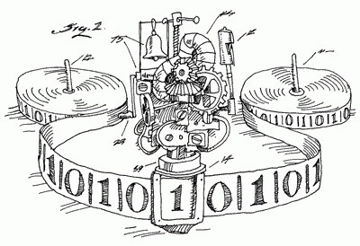
Third Semester Project Heterogenous System

Slide 2

Group 6
Group Members:
Gais El-AAsi
Marcel Notenboom
Leviticus Lyons (former)

Slide 3
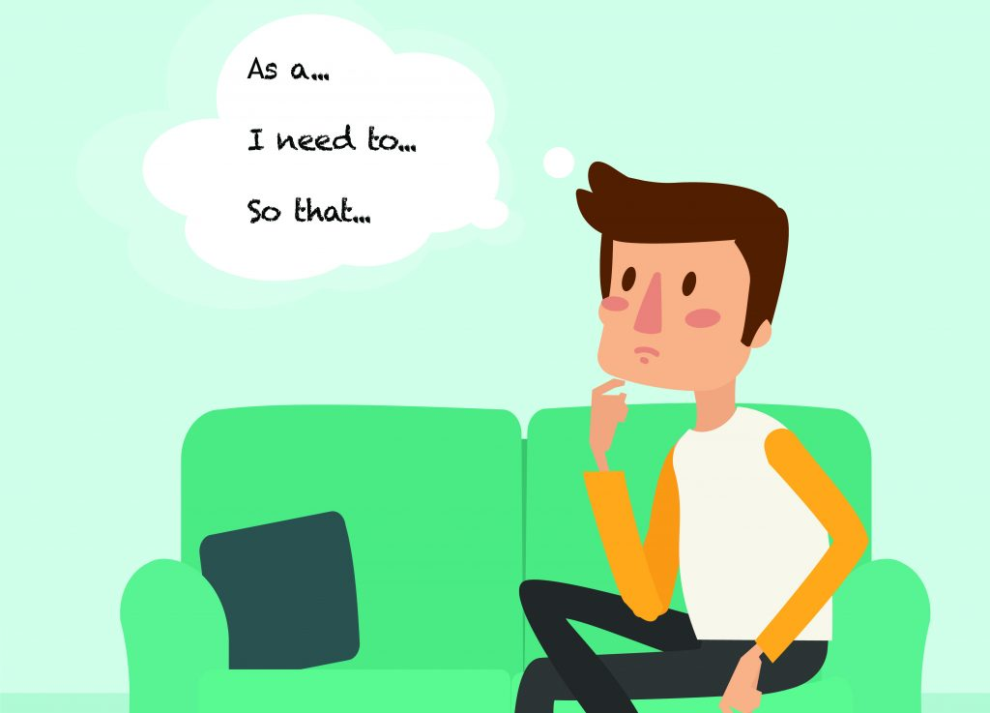
1.
Requirements

Slide 4

Requirements -user stories-
General Form
As a user-role I want feature so that a user-role can business value/benefit.
User Stories
As a Manager, I want to be able to see work and break registrations so that I can have a better understanding of who was working when.
As a Manager, I want to be able to add/edit/delete an employee from the system so that I can manage the currently employed people.
As an Employee, I want to be able to punch in/out in system quickly so that I can spend my time doing something else.
As an Employee, I want to be able to easily register when I am taking breaks so that the management knows when and how long a break was.
As a Remote Employee, I want to be able to punch in/out from any location with access to the internet so that I can work easily remotely.

Slide 5
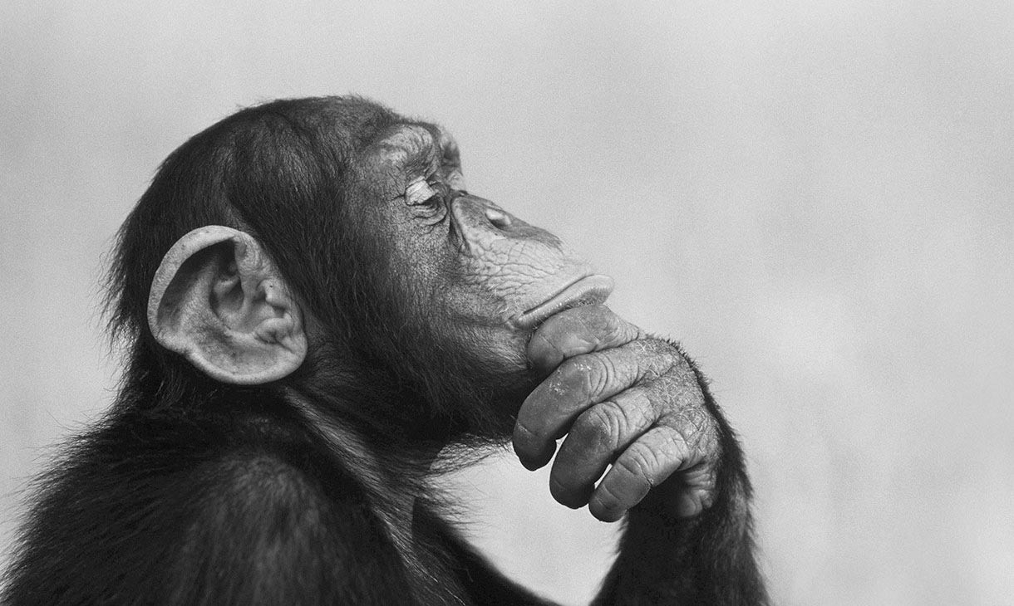
2. Analysis

Slide 6
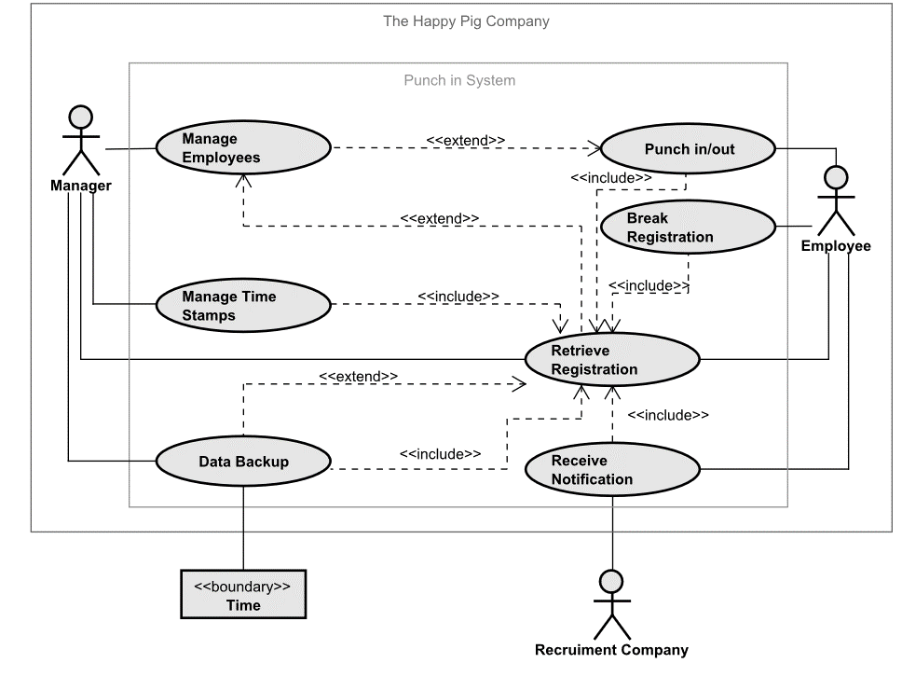
Use Case Diagram
Use Case
Diagram
Use Case Description
Domain Model

Slide 7
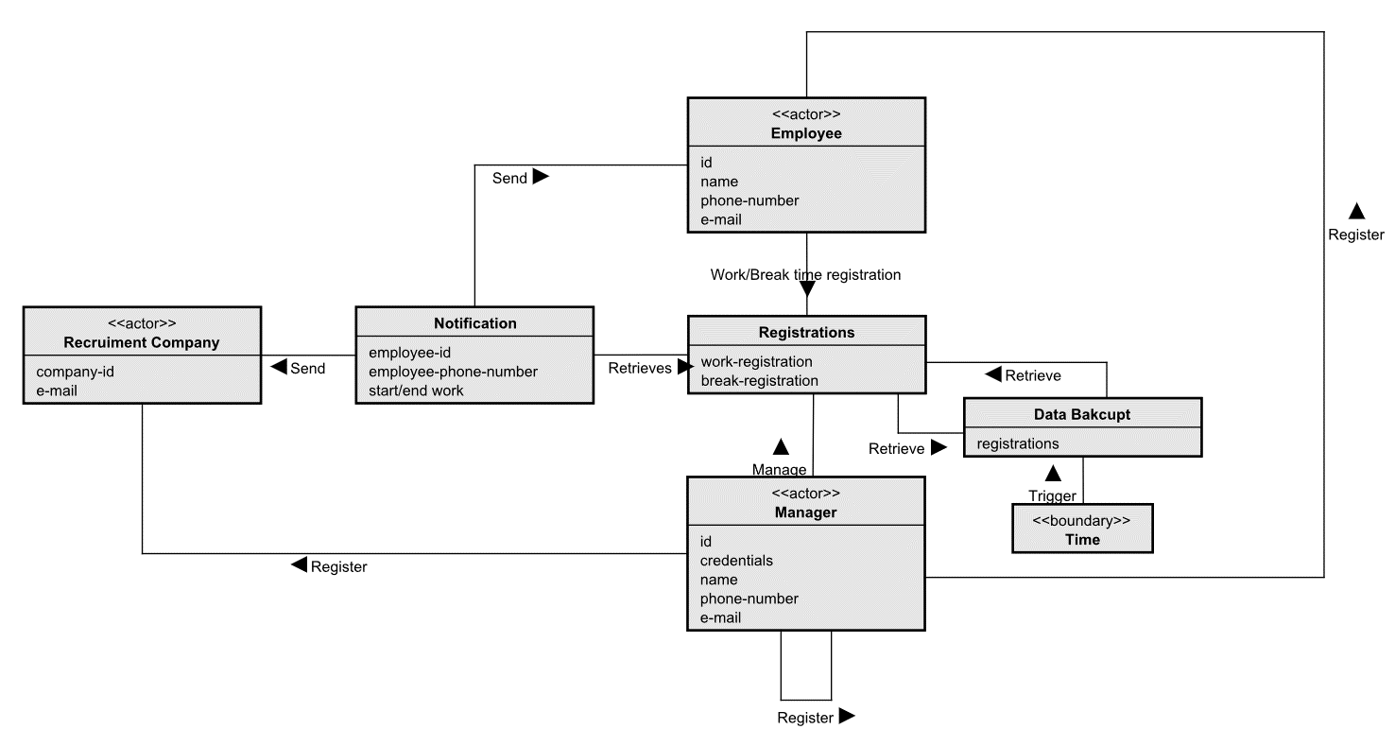
Domain Model

Slide 8
3. Design

Slide 9
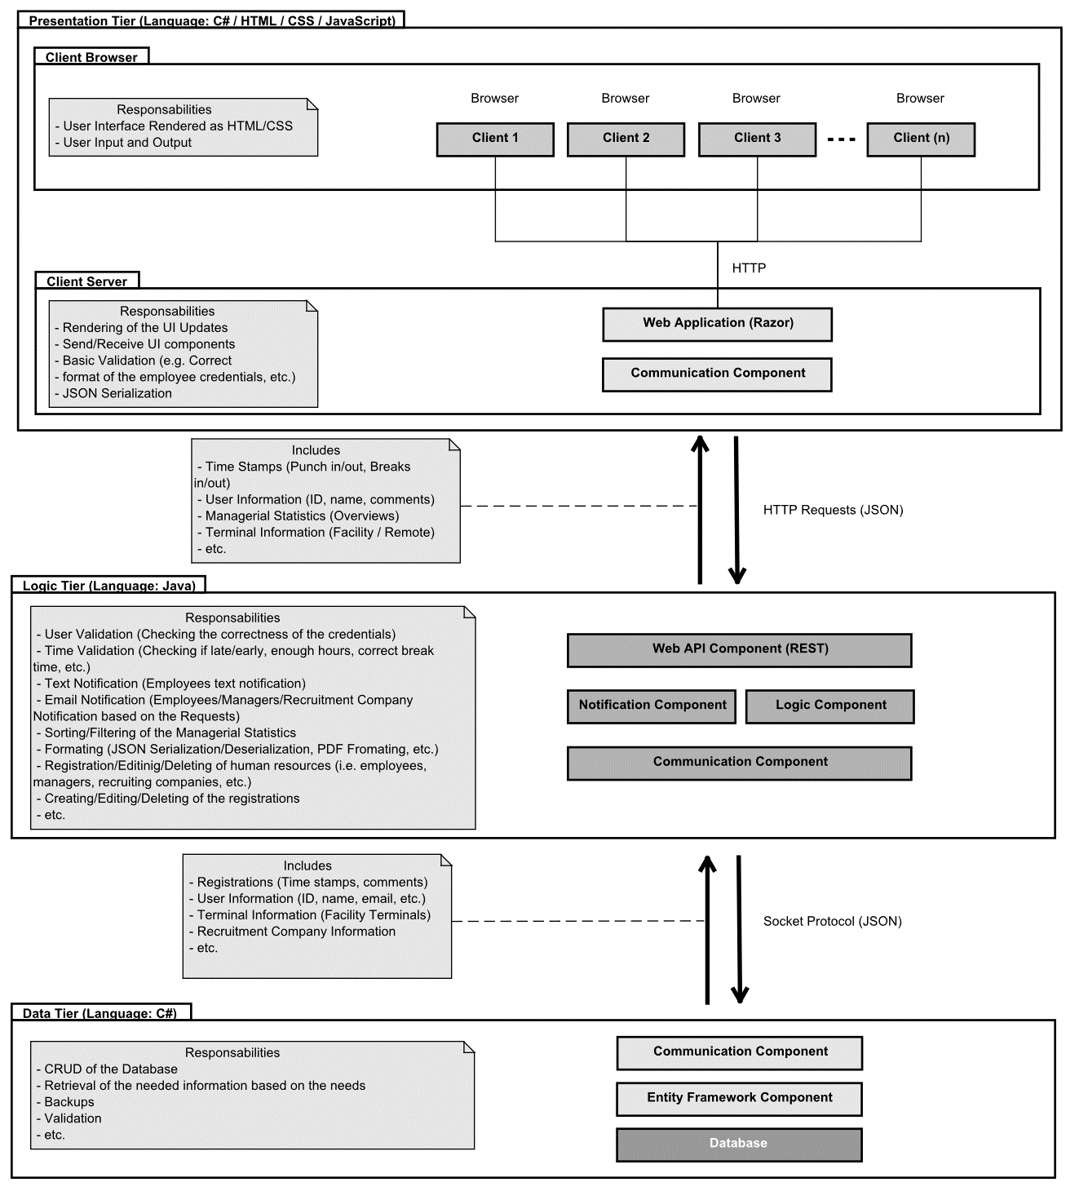
System Architecture

Slide 10

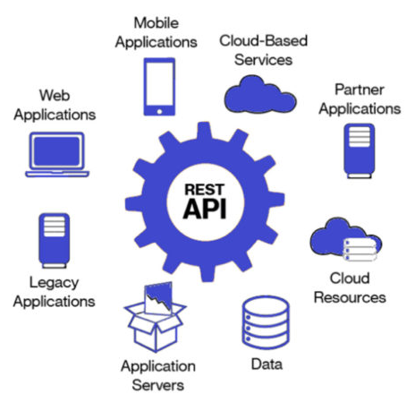
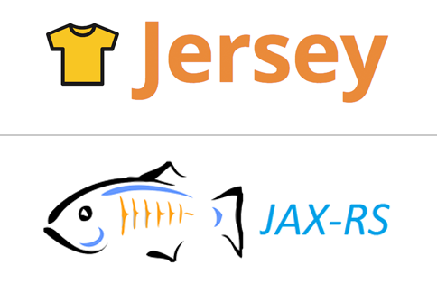

Technologies

Slide 11

4. Implementation
From design to code

Slide 12


Packet Manager

Slide 13
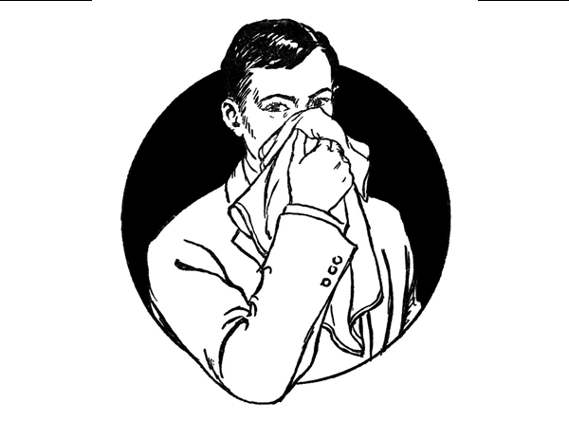
There are mistakes

Slide 14

5. Testing

Slide 15
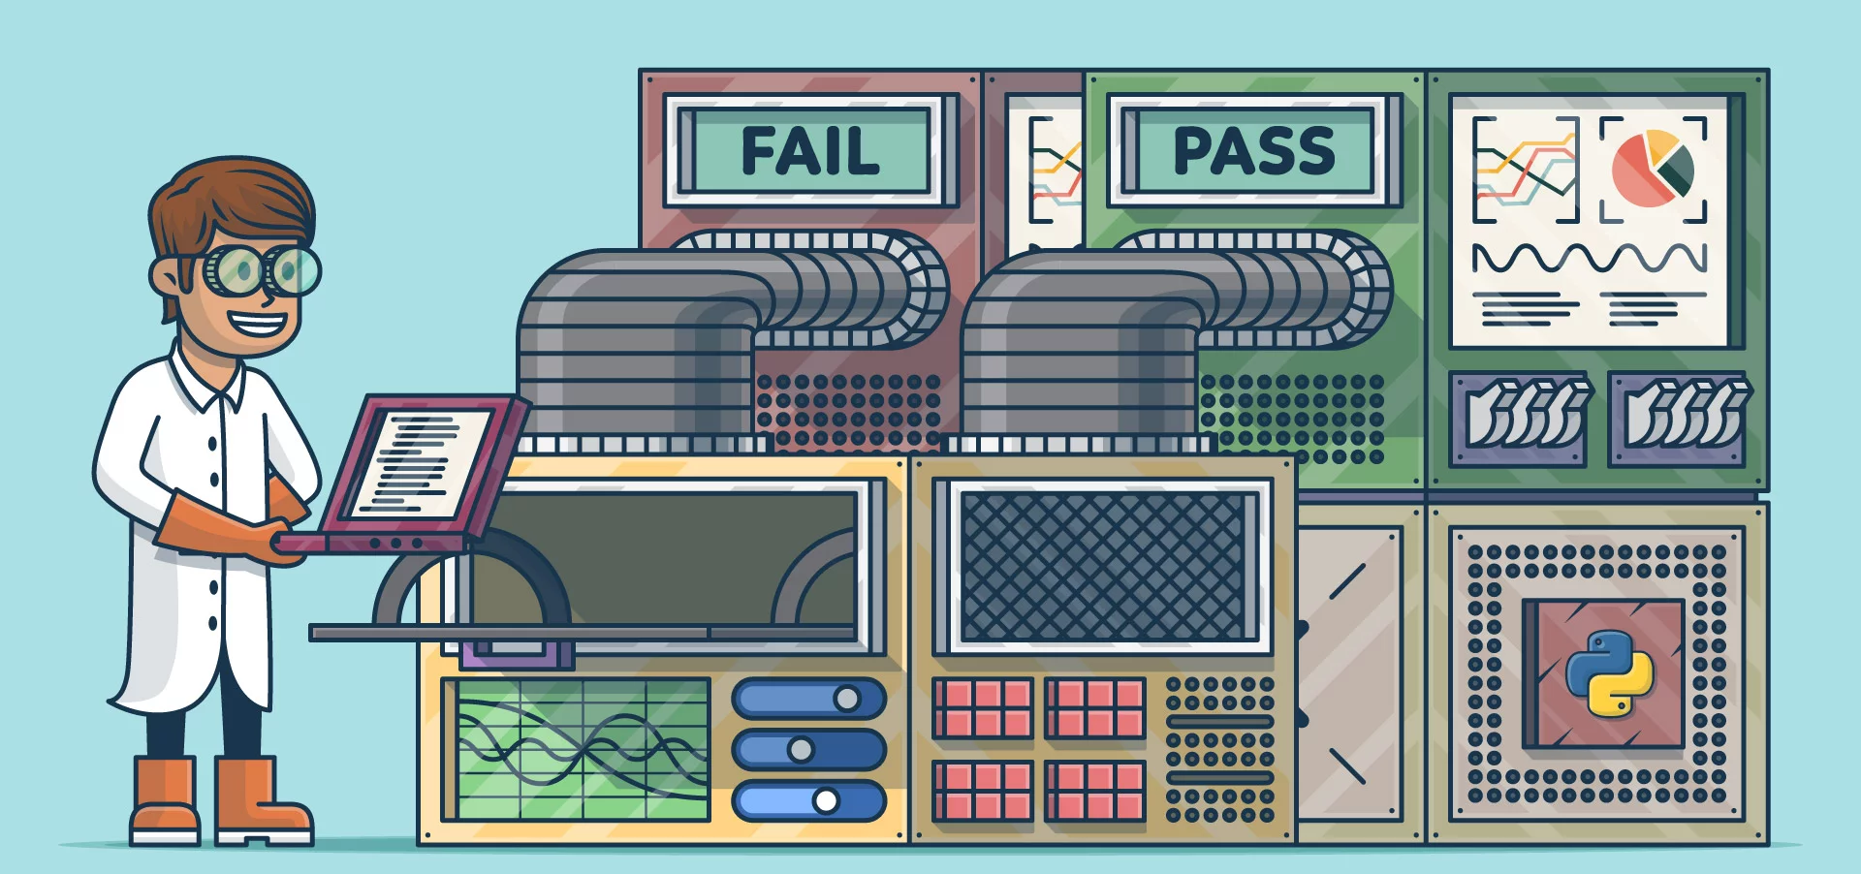

Test Cases

Slide 16
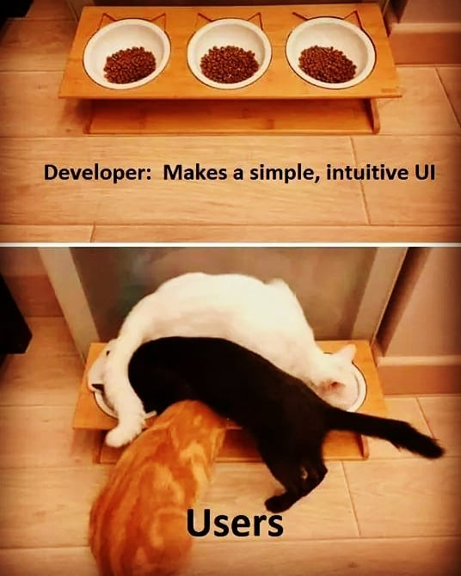
Usability Testing

Slide 17
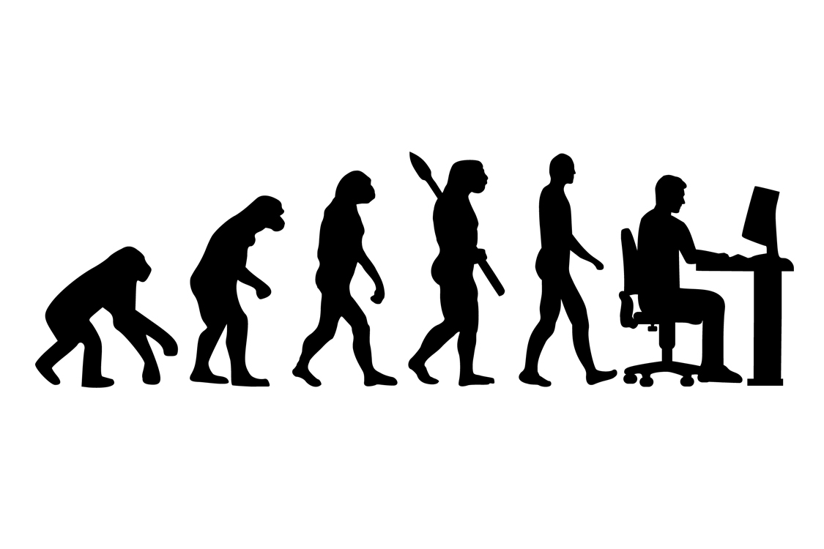
6. Conclusion

Slide 18
Problem Formulation
The time logging system used by The Happy Pig company is inefficient, prone to error, hard to store/access/maintain and easy to cheat, thus leading to a variety of negative outcomes for the company.

Slide 19
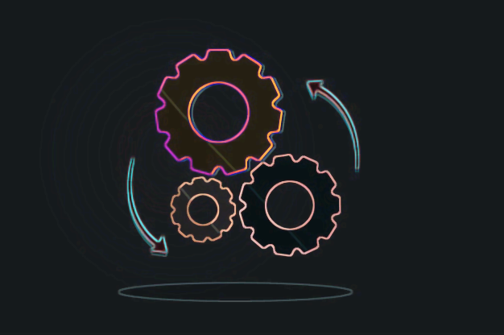
7. Process Report

Slide 20
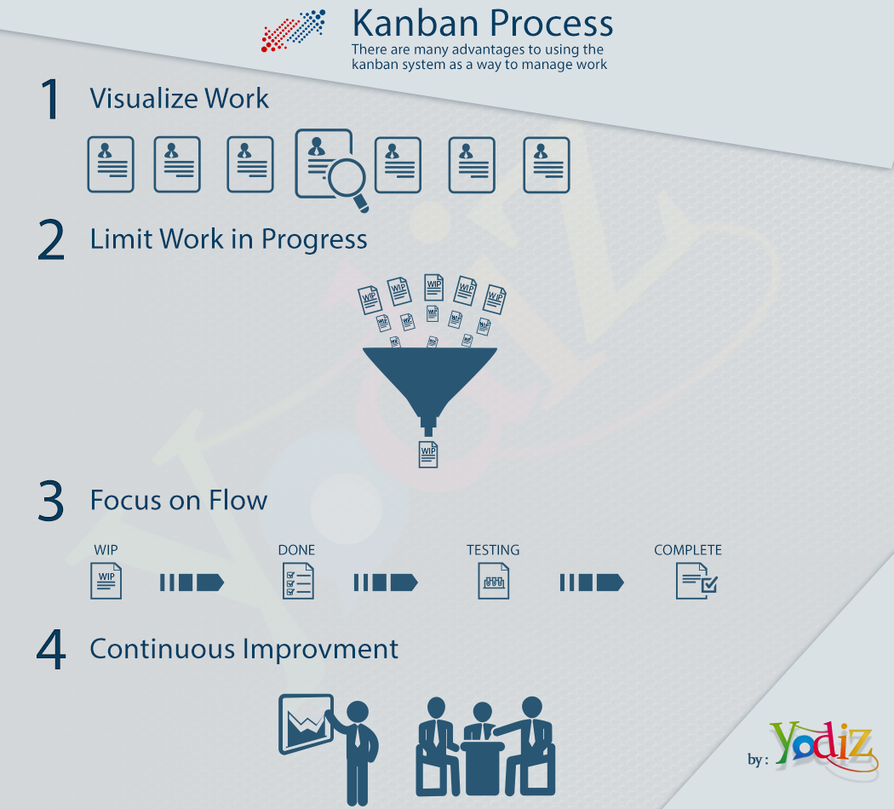
KANBAN

Slide 21


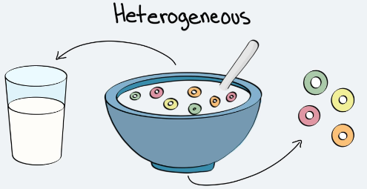

What we’ve learned
KANBAN
Version Control and Interfaces
Understand that Semester Project is a learning tool!
Packet Managers

Slide 22
Q & A
May Alan Turing be with us.

